Slide 1
Windshield Survey
Names
Institution
Course
Professor
Date

Slide 2
History
Primary Purpose of the Community’s Origins
The Bronx community came into existence as a result of European colonization.
The Bronx was originally part of the lager area of Lenape and was occupied by the Siwanoy of the Wappinger confederacy.
It branched off from the larger Westchester County IN 1874 and branched into west and east Bronx.
The borough was later converted into farmlands by the European colonialists.

Slide 3
Forecast for the Community’s Future
The Bronx area has seen significant developments since the first part of the 21st century. These developments are in infrastructure (roads and housing), and healthcare.
In the near future, the Bronx area can be predicted to have several technological developments and industries also are seen to spring up in this potential area.

Slide 4
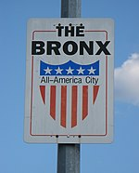
Place sign or symbolic community indicator

Slide 5
Demographics
Population Density
Jurisdiction |  | Population | GDP | Land area |  | Density
Borough | County | Census (2020) | billions (2012 US$) | square miles | square km | persons / mi² | persons / km²
The Bronx | Bronx | 1,472,654 | $ 42.695 | 42.2 | 109.3 | 34,920 | 13,482

Slide 6
Age & Gender Distribution
Population by age range
age | percentage
0 – 9 | 16%
10 – 19 | 14%
20 – 29 | 17%
30 – 39 | 14%
40 – 49 50 – 59 60 – 69 70 – 70 80+ | 12% 13% 8% 5% 1%
Females 55 % | Males 45%

Slide 7
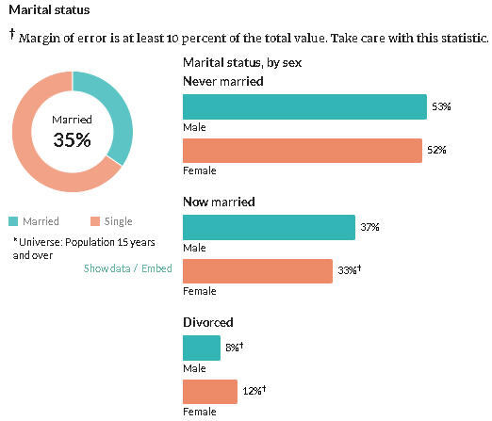
Marital Status
Marital status display.

Slide 8
Racial and Ethnic Distribution
Race | 2018^{[108]}
White | 44.9%
—Non-Hispanic | 9.1%
Black or African American | 43.6%
Hispanic or Latino (of any race) | 56.4%
Asian | 4.5%

Slide 9
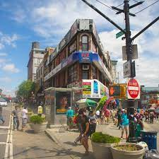
Appearance of Population on the streets

Slide 10
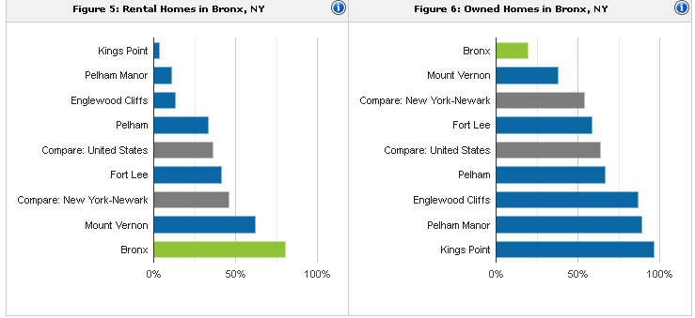
Housing
Housing density an type of housing
.

Slide 11
Affordability of Housing
Housing has been seen to be unaffordable in Bronx. Both the medium earning population and the low income earners barely have access to affordable shelter/housing.
This is because most of the people live in rental houses which are generally expensive and not affordable for the population that most is dependent on casual jobs.

Slide 12
Ownership versus Rentals
Rented | Owned | Homeless
80% | 18% | 2%

Slide 13
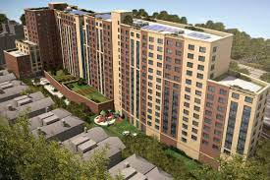
Condition of Neighborhoods in Community of Focus
,

Slide 14
Health Care & Social Services
Adequacy of Health Care and Social
Services per key stakeholders.
Health facilities in the area are well distributed within all the corners or Bronx an are quite affordable for the ever growing population.
Other social services in the area include,
          Mental health care
          Schools
          Child care centers

Slide 15
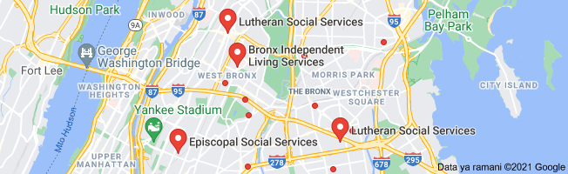
Geographic Distribution of Health Care and Social Service
The image below shows the distribution of social amenities in the area.

Slide 16
Types of Services & Resources
The services offered within these social services centers are.
          Education
          Health care
          Employment
          Transportation services

Slide 17
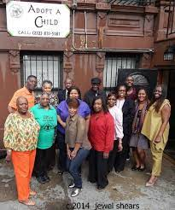
Indicator(s) of 1-2 Social Support System of the Community
.

Slide 18
Economy
Socioeconomic Status
Income range | Y-O-Y change
Average Household income | 3.9%
Median household income | 5.6%
People below poverty level | -3.9 %
People above poverty level | 1.3%

Slide 19
Financial Characteristics
The Bronx area is majorly made of medium earning persons. With the poverty rate at 26.4% in the year 2019, compared to the countywide 16%, the poverty level is seen to be higher in the area. The bigger percentage of the population earn less than 1200 USD annually.

Slide 20
Labor Force Characteristics
Joblessness Rate in Bronx County, NY was 13.40% in August of 2021, as per the United States Federal Reserve. All things considered, Unemployment Rate in Bronx County, NY arrived at a record high of 24.60% in May of 2020 and a record low of 4.20 %in December of 2019

Slide 21
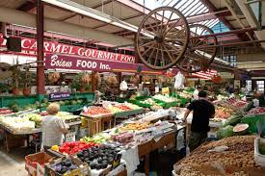
Shopping Availability/Accessibility
The healthcare sector is the most available service in the Bronx area. Therefore, the medical sector provides most of the employment slots in the area (65,800 Jobs.
Other businesses, such as vast open air markets and malls thrive well in the area.

Slide 22
Transportation
Private Transportation: estimated number of persons with a transportation disability
These group of the population involves the aged and the people with disabilities that may face challenges when using public transport.
The group consists 2% of the total population of the area, 29, 453 persons, have transport disability.

Slide 23
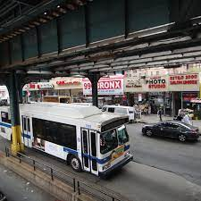
Bus Service
Bronx area has over 57 bus routes that have remained unchanged over time. Most of the population use the bus services to travel from home to the major towns for their jobs and daily transit.

Slide 24
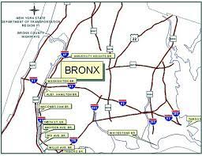
Roads & Highways
Road is the major mode of transport in the Bronx area. The major freeway in the Bronx area is Bronx Expressway which is an interstate highway.
An image showing the road network in Bronx.

Slide 25
Air & Rail Services, Commuter Services
Commuter rail services from the suburbs is run by two agencies within Bronx area. The MTA, which operates Long Island rail road and the Main –North Railroad which
The area also hosts one of the top international air passenger gateway to the whole U.S, the JFK.
Other transport media include water boats and passenger ships .

Slide 26
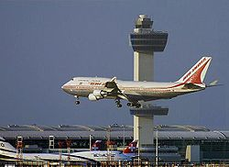
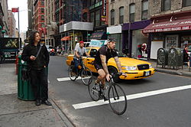
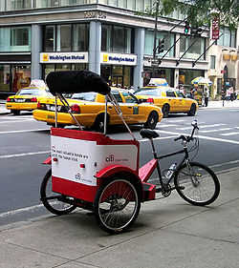
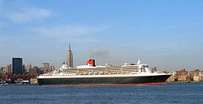
Transport systems in the Bronx area

Slide 27
References
Berechman, J. (1995). Transport infrastructure investment and economic development. Transport and Urban Development, E&FN Spon, London, 17-35.
Price, O. A. (2017). Strategies to encourage long-term sustainability of school-based health centers. American Journal of Medical Research, 4(1), 61-83.
Wallace, R. (1990). Urban desertification, public health and public order:‘planned shrinkage’, violent death, substance abuse and AIDS in the Bronx. Social science & medicine, 31(7), 801-813.

